Slide 1
Software Engineering Lecture 5
By
Engr. Sara Rehmat
MS (CS)

Slide 2
Extreme Programming (XP) – An Agile Method
The most widely used agile process, originally proposed by Kent Beck
XP Planning
Begins with the creation of “user stories”
Agile team assesses each story and assigns a cost
Stories are grouped to for a deliverable increment
A commitment is made on delivery date
After the first increment “project velocity” is used to help define subsequent delivery dates for other increments

Slide 3
Extreme Programming (XP)
XP Design
Follows the KIS principle
Encourage the use of CRC cards
For difficult design problems, suggests the creation of “spike solutions”—a design prototype
Encourages “refactoring”—an iterative refinement of the internal program design

Slide 4
XP Coding
Recommends the construction of a unit test for a store before coding commences
Encourages “pair programming”
XP Testing
All unit tests are executed daily
“Acceptance tests” are defined by the customer and executed to assess customer visible functionality

Slide 5
Extreme Programming (XP)

Slide 6
XP Programming
A very influential agile method, developed in the late 1990s, that introduced a range of agile development techniques.
Extreme Programming (XP) takes an ‘extreme’ approach to iterative development.
New versions may be built several times per day;
Increments are delivered to customers every 2 weeks;
All tests must be run for every build and the build is only accepted if tests run successfully.

Slide 7
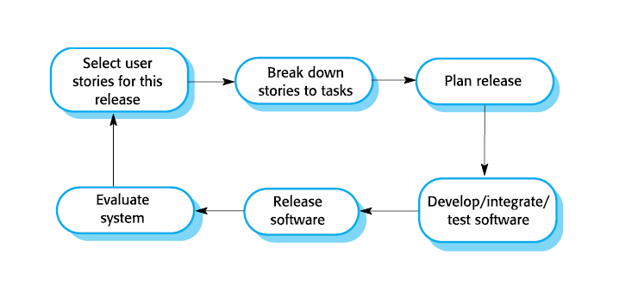
The extreme programming release cycle

Slide 8
XP Method and Agile Principles
Incremental development is supported through small, frequent system releases.
Customer involvement means full-time customer engagement with the team.
People not process through pair programming, collective ownership and a process that avoids long working hours.
Change supported through regular system releases.
Maintaining simplicity through constant refactoring of
code.

Slide 9
Influential XP practices
Extreme programming has a technical focus and is not easy to integrate with management practice in most organizations.
Consequently, while agile development uses practices from XP, the method as originally defined is not widely used.
Key practices
User stories for specification
Refactoring
Test-first development
Pair programming

Slide 10
User stories for requirements
In XP, a customer or user is part of the XP team and is responsible for making decisions on requirements.
User requirements are expressed as user stories or scenarios.
These are written on cards and the development team break them down into implementation tasks. These tasks are the basis of schedule and cost estimates.
The customer chooses the stories for inclusion in the next release based on their priorities and the schedule estimates.

Slide 11
Refactoring
Conventional wisdom in software engineering is to design for change. It is worth spending time and effort anticipating changes as this reduces costs later in the life cycle.
XP, however, maintains that this is not worthwhile as changes cannot be reliably anticipated.
Rather, it proposes constant code improvement (refactoring) to make changes easier when they have to be implemented.

Slide 12
Refactoring
Programming team look for possible software improvements and make these improvements even where there is no immediate need for them.
This improves the understandability of the software and so reduces the need for documentation.
Changes are easier to make because the code is well structured and clear.
However, some changes requires architecture refactoring and this is much more expensive.

Slide 13
Examples of Refactoring
Re-organization of a class hierarchy to remove duplicate code.
Tidying up and renaming attributes and methods to make them easier to understand.
The replacement of inline code with calls to methods that have been included in a program library.

Slide 14
Test-first development
Testing is central to XP and XP has developed an approach where the program is tested after every change has been made.
XP testing features:
Test-first development.
Incremental test development from scenarios.
User involvement in test development and validation.
Automated test harnesses are used to run all component tests each time that a new release is built.

Slide 15
Test-first development
Writing tests before code clarifies the requirements to be implemented.
Tests are written as programs rather than data so that they can be executed automatically. The test includes a check that it has executed correctly.
Usually relies on a testing framework such as Junit.
All previous and new tests are run automatically when new functionality is added, thus checking that the new functionality has not introduced errors.

Slide 16
Customer involvement
The role of the customer in the testing process is to help develop acceptance tests for the stories that are to be implemented in the next release of the system.
The customer who is part of the team writes tests as development proceeds. All new code is therefore validated to ensure that it is what the customer needs.
However, people adopting the customer role have limited time available and so cannot work full-time with the development team. They may feel that providing the requirements was enough of a contribution and so may be reluctant to get involved in the testing process.

Slide 17
Test automation
Test automation means that tests are written as executable components before the task is implemented
These testing components should be stand-alone, should simulate the submission of input to be tested and should check that the result meets the output specification. An automated test framework (e.g. Junit) is a system that makes it easy to write executable tests and submit a set of tests for execution.
As testing is automated, there is always a set of tests that can be quickly and easily executed
Whenever any functionality is added to the system, the tests can be run and problems that the new code has introduced can be caught immediately.

Slide 18
Problems with test-first development
Programmers prefer programming to testing and sometimes they take short cuts when writing tests. For example, they may write incomplete tests that do not check for all possible exceptions that may occur.
Some tests can be very difficult to write incrementally.
For example, in a complex user interface, it is often difficult to write unit tests for the code that implements the ‘display logic’ and workflow between screens.
It difficult to judge the completeness of a set of tests. Although you may have a lot of system tests, your test set may not provide complete coverage.

Slide 19
Pair programming
Pair programming involves programmers working in pairs, developing code together.
This helps develop common ownership of code and spreads knowledge across the team.
It serves as an informal review process as each line of code is looked at by more than 1 person.
It encourages refactoring as the whole team can benefit from improving the system code.

Slide 20
Pair programming
Pairs are created dynamically so that all team members work with each other during the development process.
The sharing of knowledge that happens during pair programming is very important as it reduces the overall risks to a project when team members leave.
Pair programming is not necessarily inefficient and there is some evidence that suggests that a pair working together is more efficient than 2 programmers working separately.

Slide 21
Agile Project Management
The principal responsibility of software project managers is to manage the project so that the software is delivered on time and within the planned budget for the project.
The standard approach to project management is plan driven. Managers draw up a plan for the project showing what should be delivered, when it should be delivered and who will work on the development of the project deliverables.
Agile project management requires a different approach, which is adapted to incremental development and the practices used in agile methods.

Slide 22

Scrum
Scrum is an agile method that focuses on managing iterative development rather than specific agile practices.
A scrum (short for scrummage) is a method of restarting play in rugby football that involves players packing closely together with their heads down and attempting to gain possession of the ball.

Slide 23
Scrum
There are three phases in Scrum.
The initial phase is an outline planning phase where you establish the general objectives for the project and design the software architecture.
This is followed by a series of sprint cycles, where each cycle develops an increment of the system.
The project closure phase wraps up the project, completes required documentation such as system help frames and user manuals and assesses the lessons learned from the project.

Slide 24
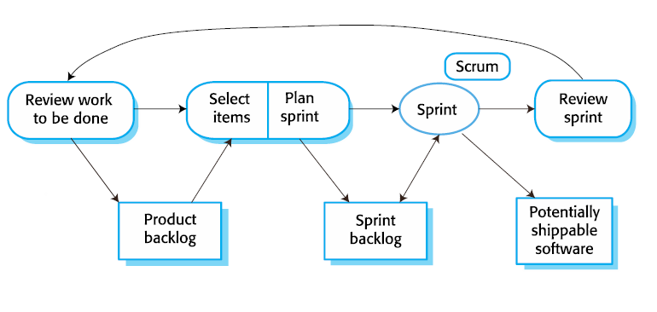
Scrum sprint cycle

Slide 25
The Scrum sprint cycle
Sprints are fixed length, normally 2–4 weeks.
The starting point for planning is the product backlog, which is the list of work to be done on the project.
The selection phase involves all of the project team who work with the customer to select the features and functionality from the product backlog to be developed during the sprint.

Slide 26
The Sprint cycle
Once these are agreed, the team organize themselves to develop the software.
During this stage the team is isolated from the customer and the organization, with all communications channelled through the so-called ‘Scrum master’.
The role of the Scrum master is to protect the development team from external distractions.
At the end of the sprint, the work done is reviewed and presented to stakeholders. The next sprint cycle then begins.

Slide 27
The Sprint cycle
The ‘Scrum master’ is a facilitator who arranges daily meetings, tracks the backlog of work to be done, records decisions, measures progress against the backlog and communicates with customers and management outside of the team.
The whole team attends short daily meetings (Scrums) where all team members share information, describe their progress since the last meeting, problems that have arisen and what is planned for the following day.
This means that everyone on the team knows what is going on and, if problems arise, can re-plan short-term work to cope with them.

Slide 28
Teamwork in Scrum
The product is broken down into a set of manageable and understandable chunks.
Unstable requirements do not hold up progress. The whole team have visibility of everything and consequently team communication is improved.
Customers see on-time delivery of increments and gain feedback on how the product works.
Trust between customers and developers is established and a positive culture is created in which everyone expects the project to succeed.

Slide 29
Scaling Agile Methods
Agile methods have proved to be successful for small and medium sized projects that can be developed by a small co-located team.
It is sometimes argued that the success of these methods comes because of improved communications which is possible when everyone is working together.
Scaling up agile methods involves changing these to cope with larger, longer projects where there are multiple development teams, perhaps working in different locations.

Slide 30
Scaling out and scaling up
‘Scaling up’ is concerned with using agile methods for developing large software systems that cannot be developed by a small team.
‘Scaling out’ is concerned with how agile methods can be introduced across a large organization with many years of software development experience.
When scaling agile methods it is important to maintain agile fundamentals:
Flexible planning, frequent system releases, continuous integration, test-driven development and good team communications.

Slide 31
Practical problems with agile methods
The informality of agile development is incompatible with the legal approach to contract definition that is commonly used in large companies.
Agile methods are most appropriate for new software development rather than software maintenance. Yet the majority of software costs in large companies come from maintaining their existing software systems.
Agile methods are designed for small co-located teams yet much software development now involves worldwide distributed teams.

Slide 32
Agile methods and software maintenance
Most organizations spend more on maintaining existing software than they do on new software development. So, if agile methods are to be successful, they have to support maintenance as well as original development.
Two key issues:
Are systems that are developed using an agile approach maintainable, given the emphasis in the development process of minimizing formal documentation?
Can agile methods be used effectively for evolving a system in response to customer change requests?
Problems may arise if original development team cannot be maintained.

Slide 33
Agile Maintenance
Key problems are:
Lack of product documentation
Keeping customers involved in the development process
Maintaining the continuity of the development team
Agile development relies on the development team knowing and understanding what has to be done.
For long-lifetime systems, this is a real problem as the original developers will not always work on the system.

